Slide 1

SQL Project
Video link:https://drive.google.com/file/d/1zjG1qR9W0P1PnoYyEROquT7EyzRKqiR4/view?usp=sharing

Slide 2
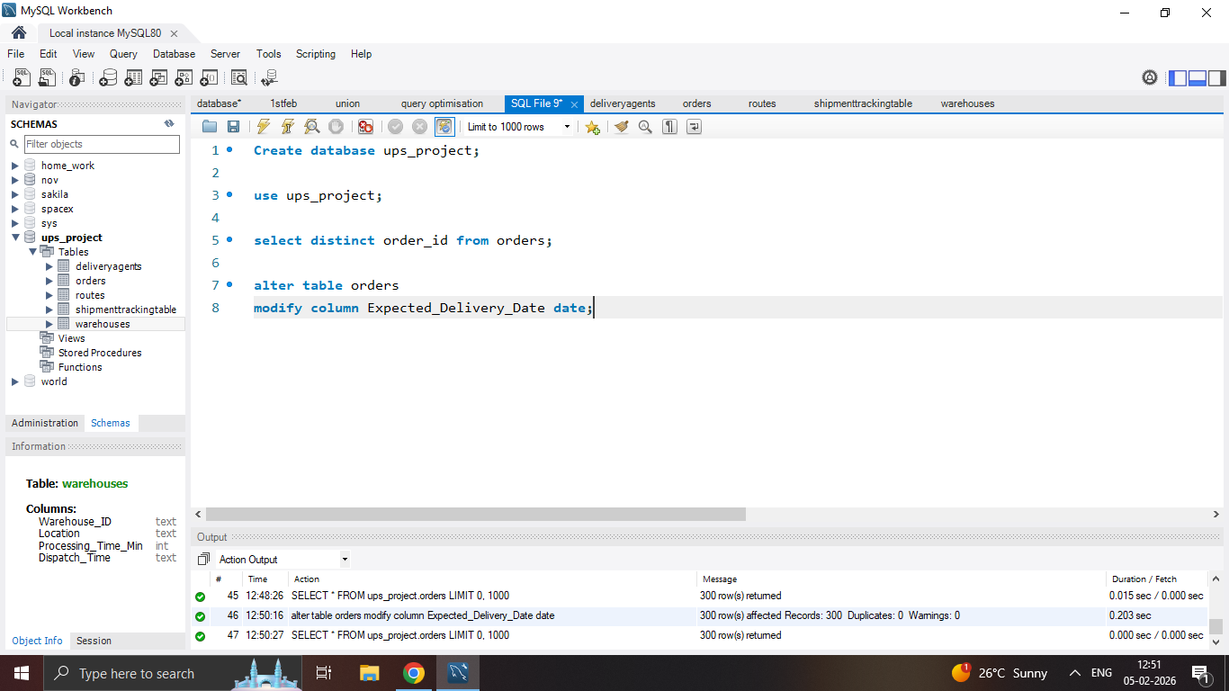
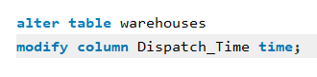


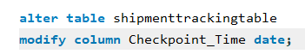
Task 1
Converting all date column into Date format
Converting time column into Time format

Slide 3
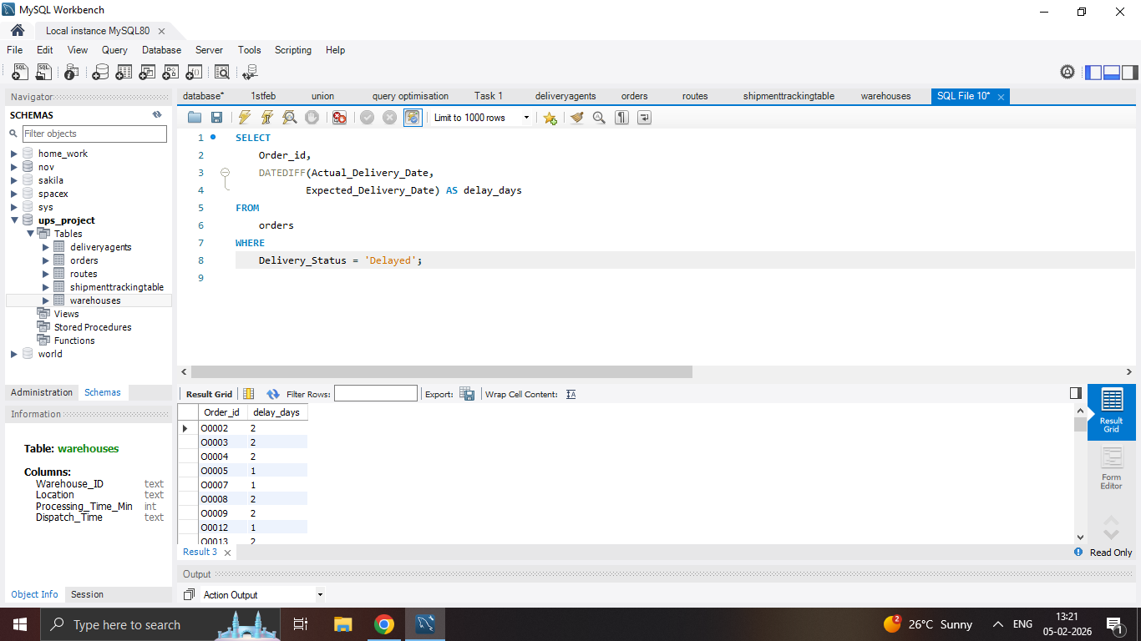
Task 2
Calculate delivery delay (in days) for each order
Result:

Slide 4
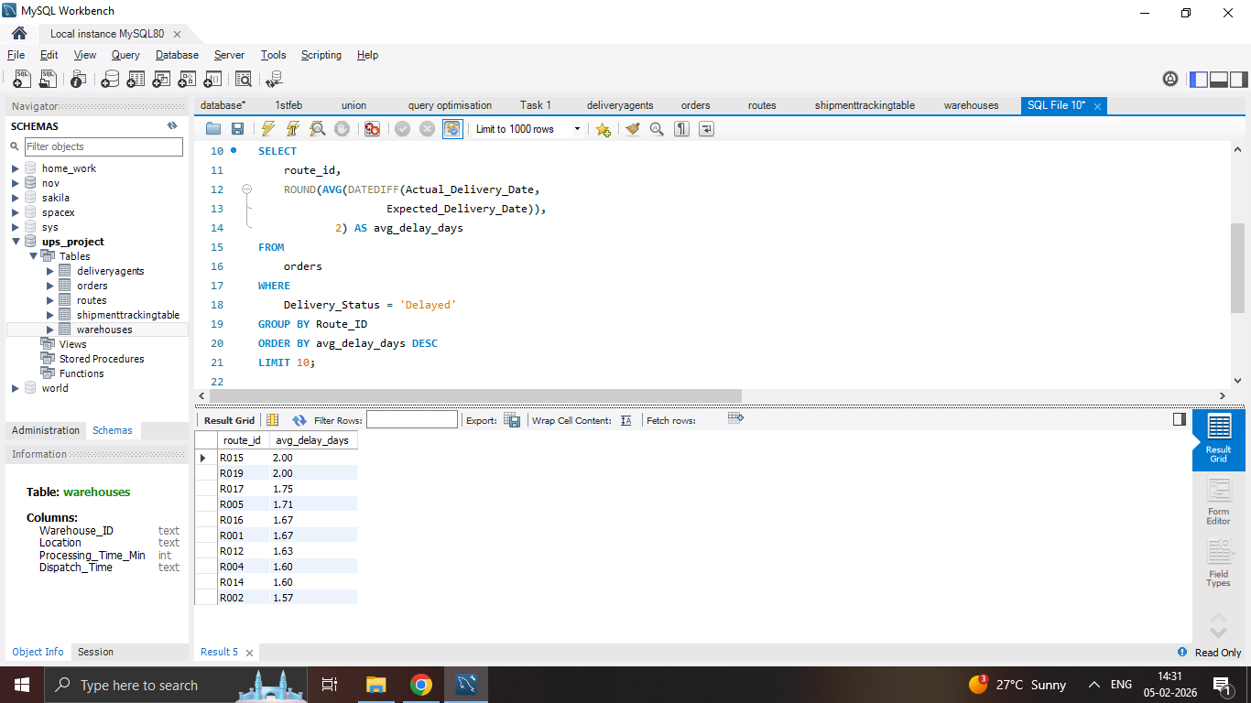
Task 2
Top 10 delayed routes based on average delay days
Result:

Slide 5
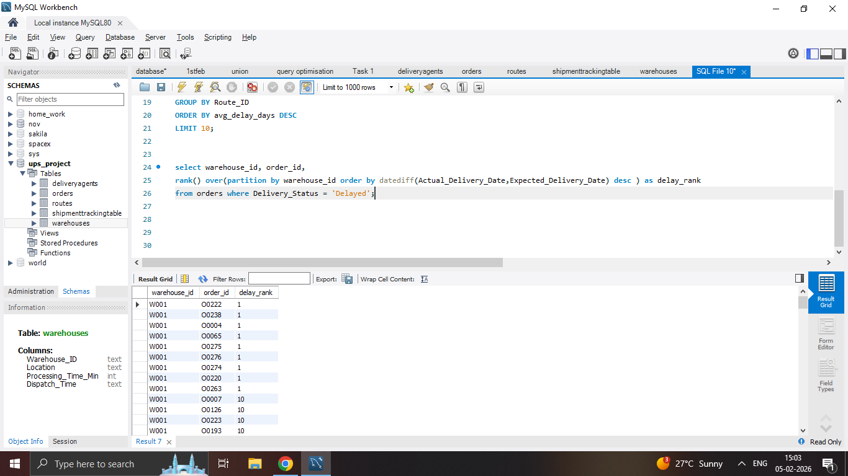
Task 2
Use window functions to rank all orders by delay within each warehouse
Result:

Slide 6
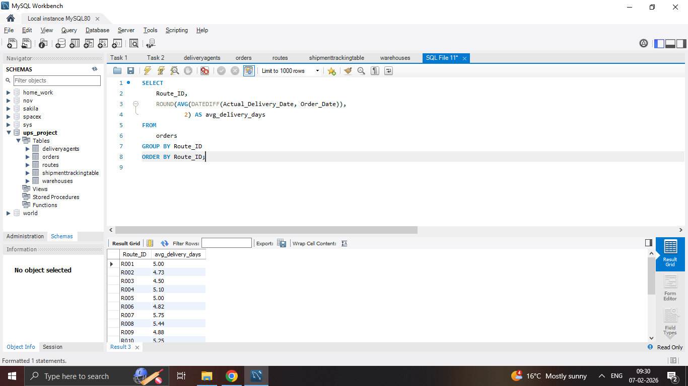
Task 3
Average delivery time (in days)
Result:

Slide 7
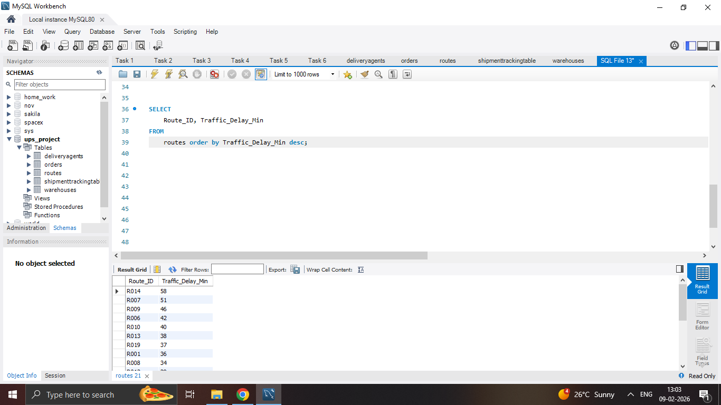
Task 3
Average traffic delay
Result:

Slide 8
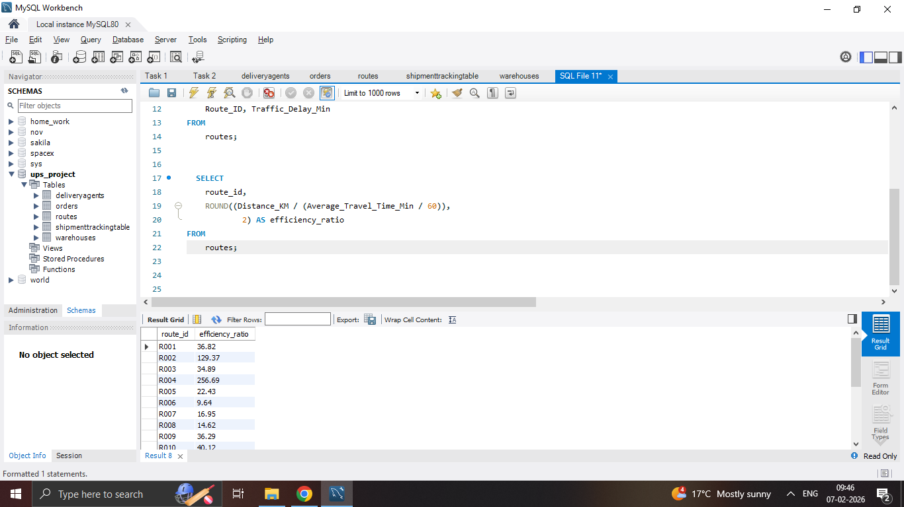
Task 3
Distance-to-time efficiency ratio: Distance_KM / Average_Travel_Time_Min
Result:

Slide 9
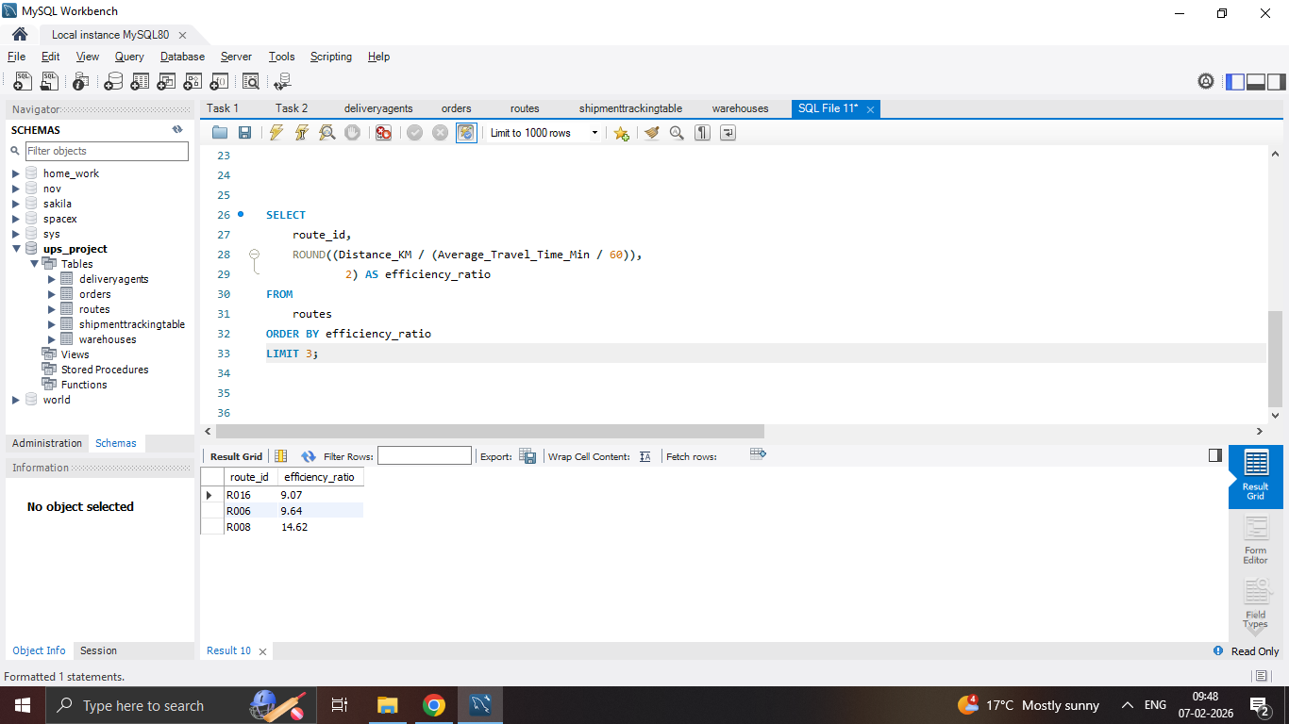
Task 3
Identify 3 routes with the worst efficiency ratio
Result:
:-These are the worst routes so company should optimize these routes.

Slide 10
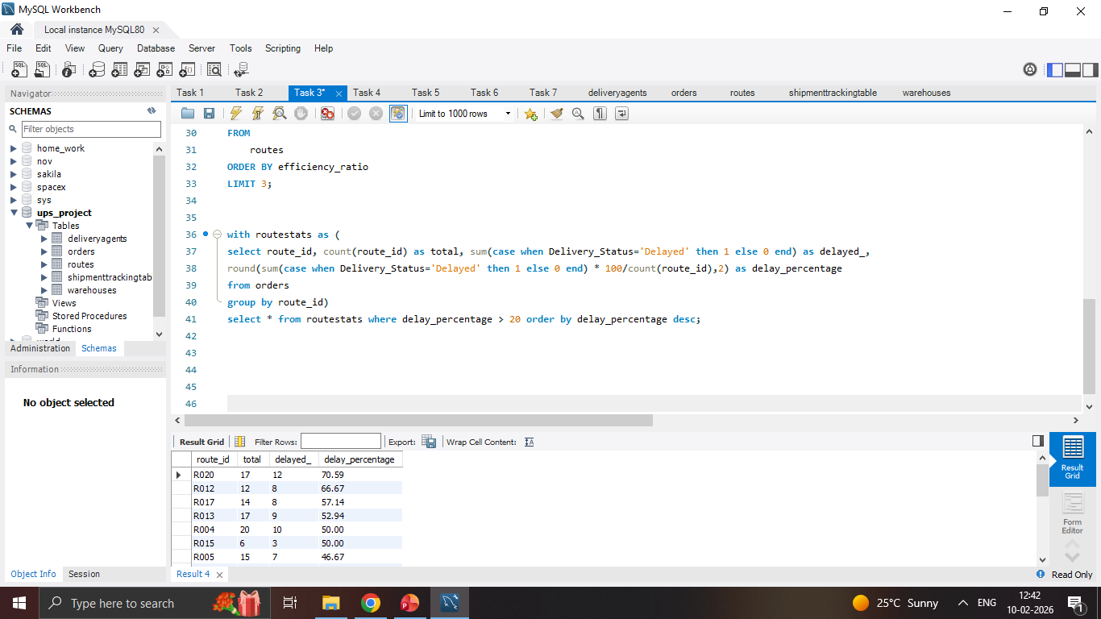
Task 3
Find routes with >20% delayed shipments
Result:

Slide 11
Task 3
Recommendation:
- Routes with low efficiency ratio and high delay percentage need redesign.
- Need to relocate experienced agents to poor performing routes.

Slide 12
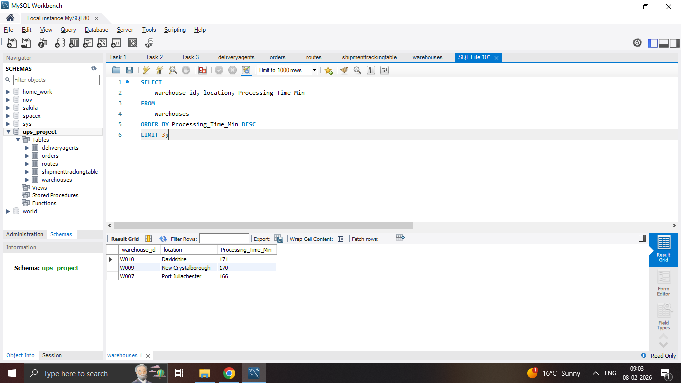
Task 4
Top 3 warehouses with the highest average processing time
Result:

Slide 13
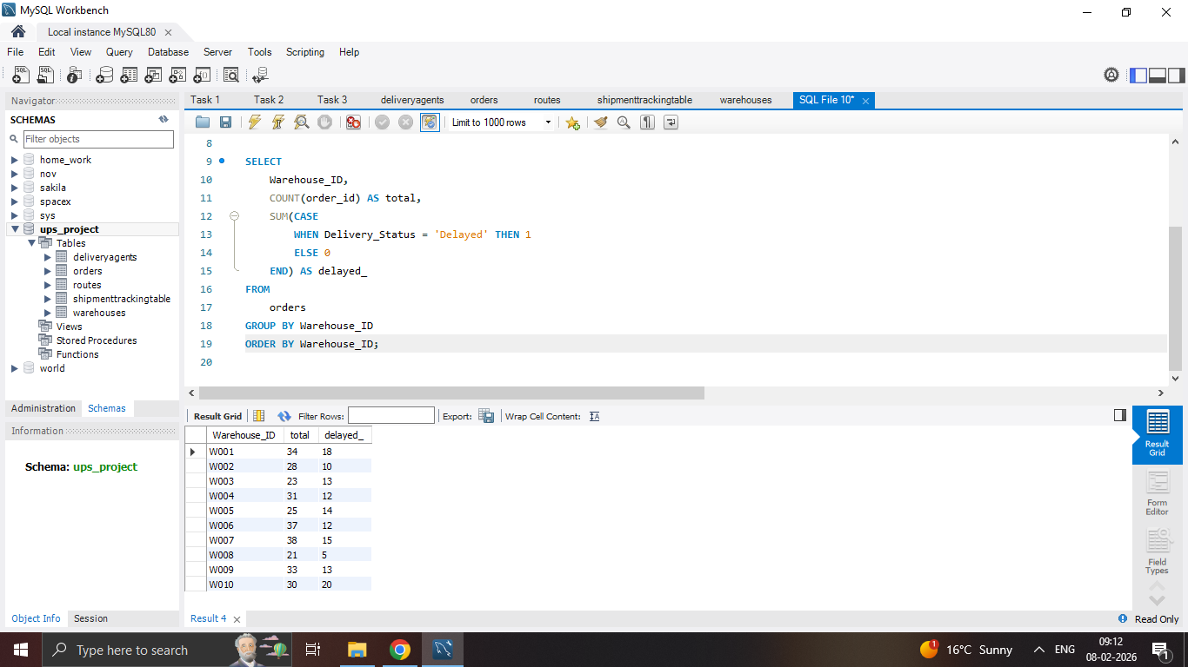
Task 4
Total vs. delayed shipments for each warehouse
Result:

Slide 14
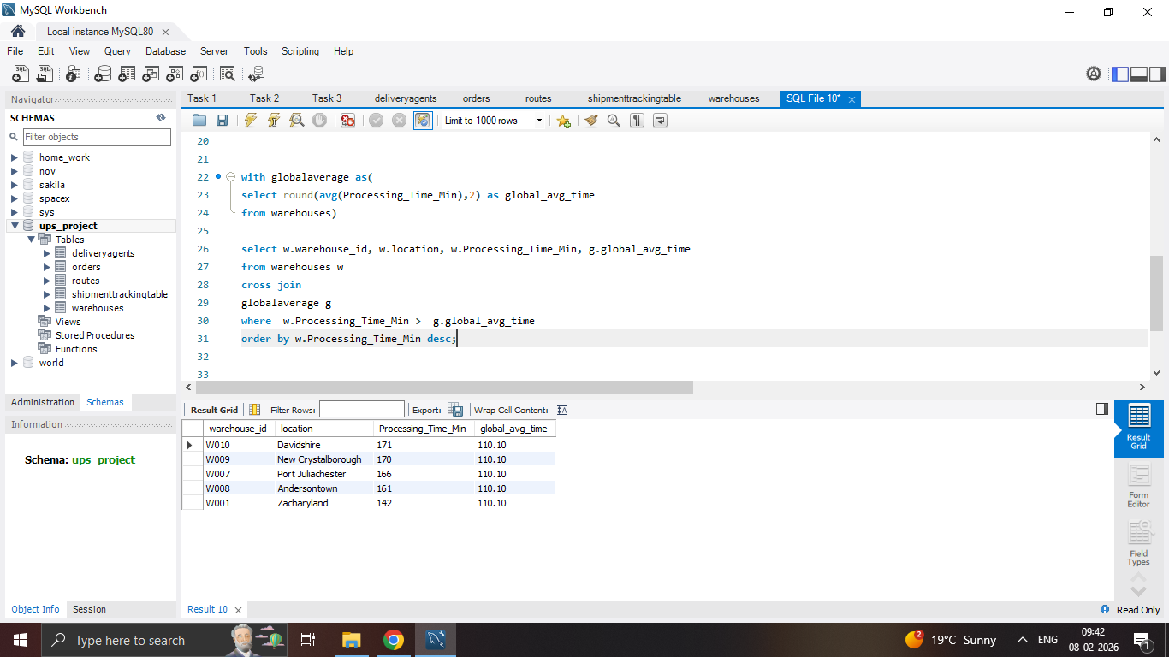
Task 4
Processing time > global average
Result:

Slide 15
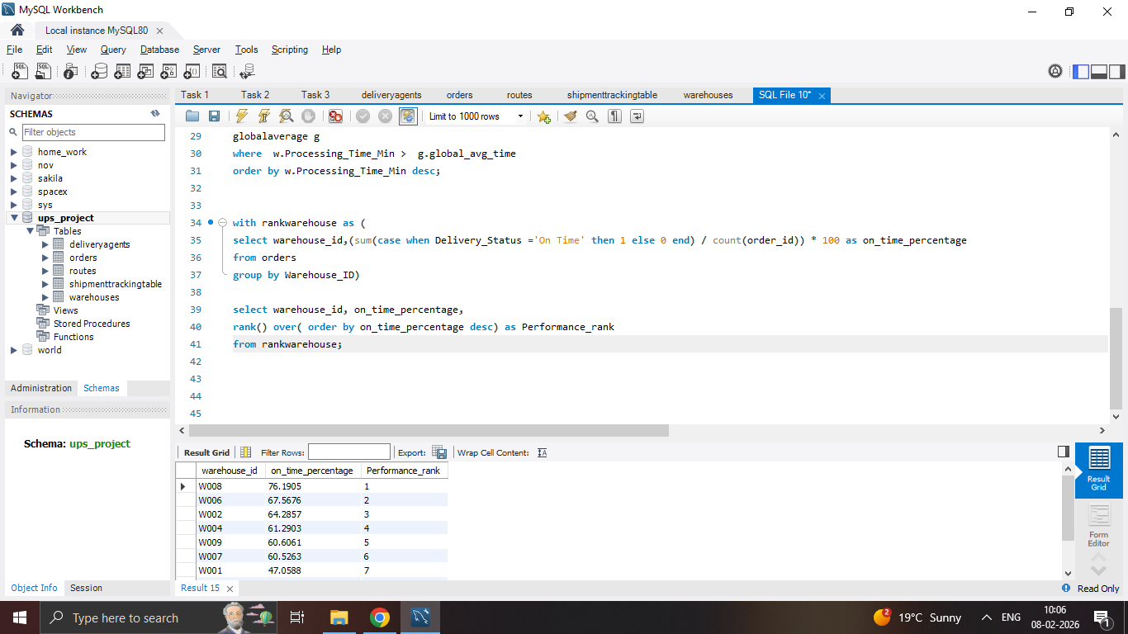
Task 4
Rank warehouses based on on-time delivery percentage
Result:

Slide 16
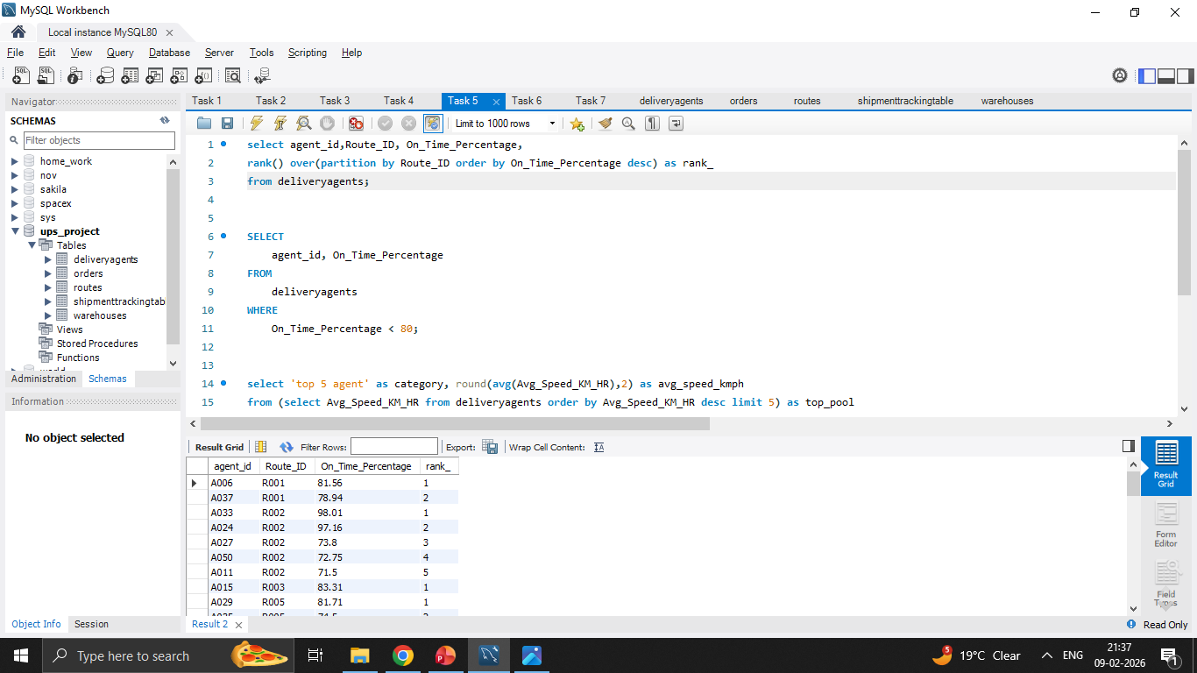
Task 5
Rank agents (per route) by on-time delivery percentage
Result:

Slide 17
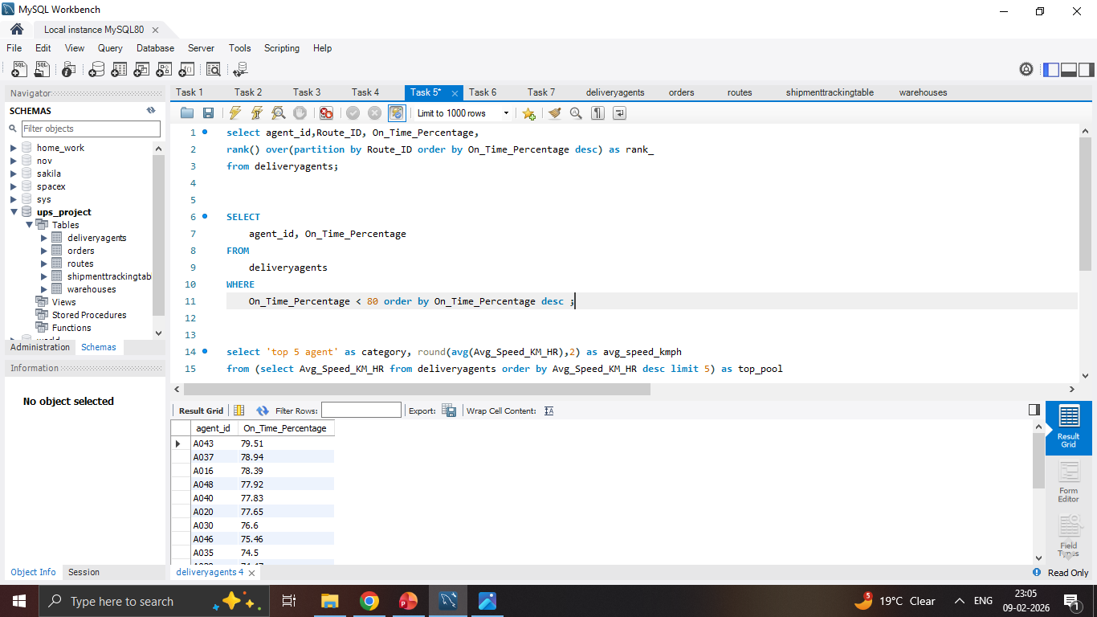
Task 5
Agents with on-time % < 80%
Result:

Slide 18
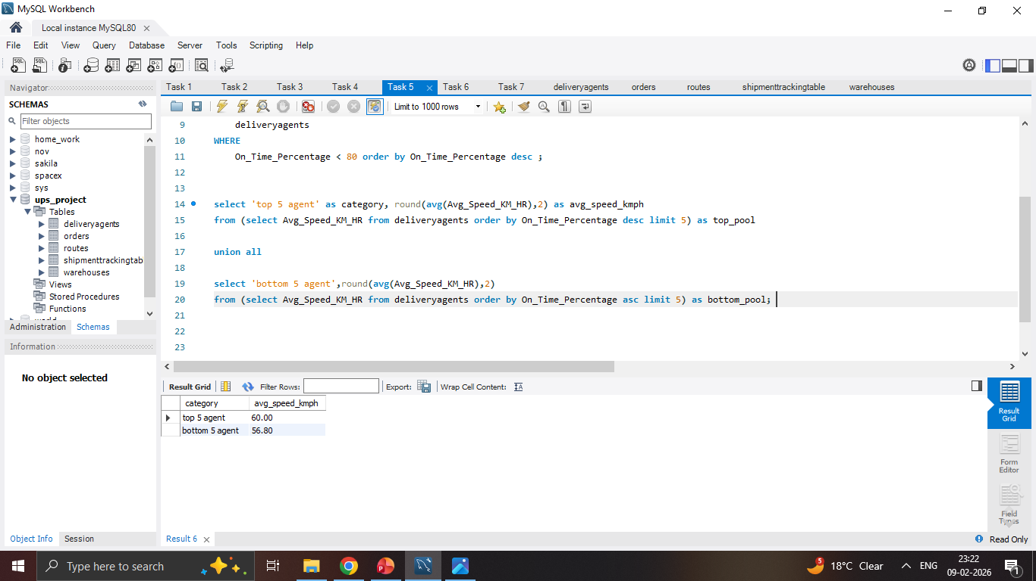
Task 5
Compare average speed of top 5 vs bottom 5 agents
Result:

Slide 19
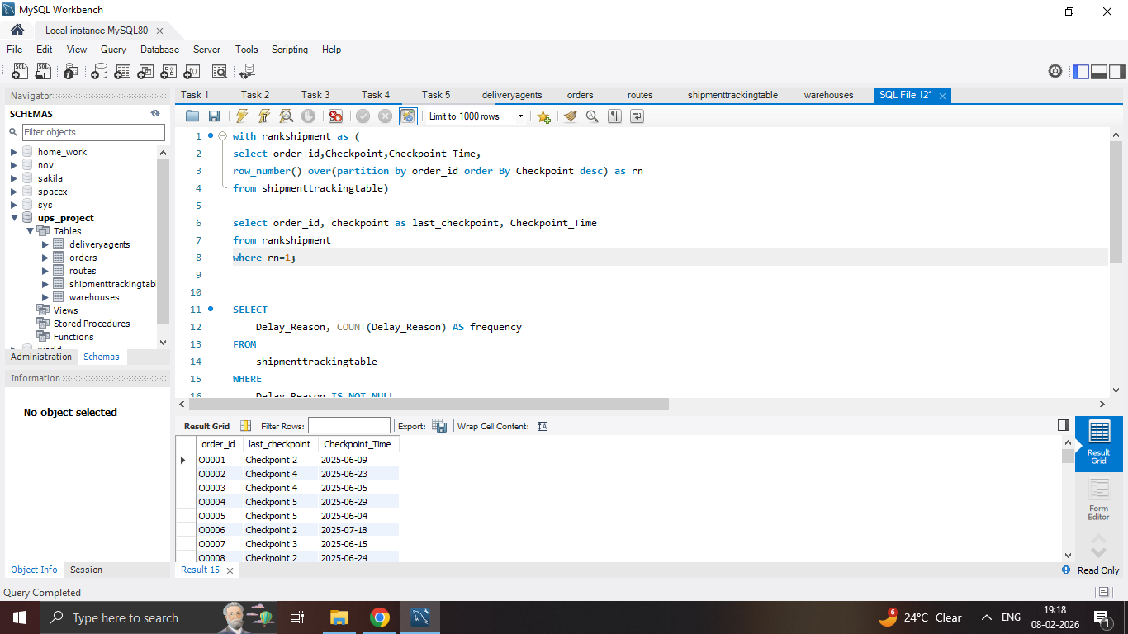
Task 6
Last checkpoint and time for each order
Result:

Slide 20
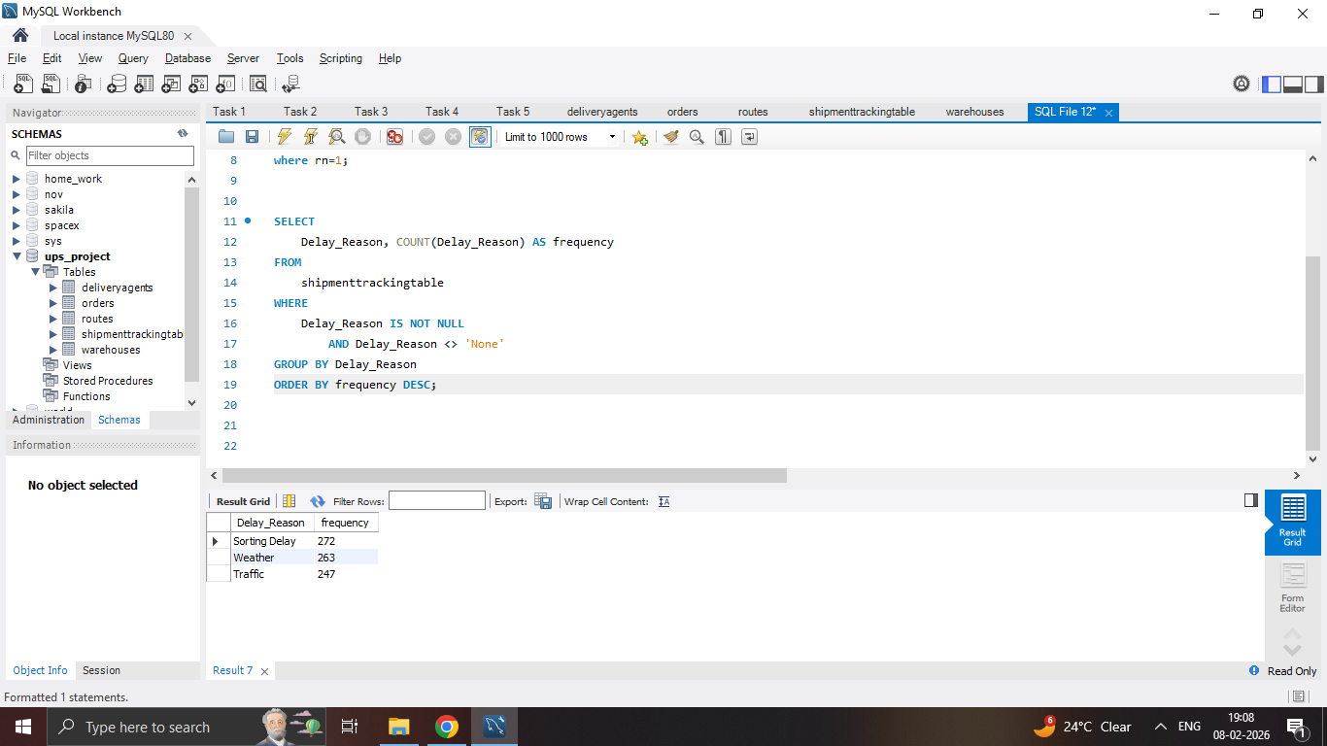
Task 6
Find the most common delay reasons (excluding None)
Result:

Slide 21
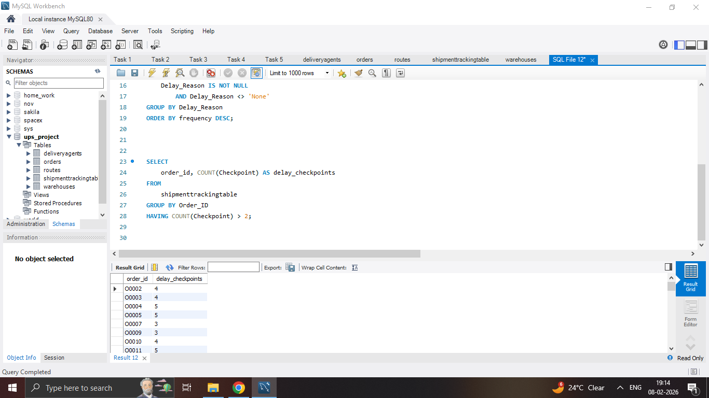
Task 6
Orders with >2 delayed checkpoints
Result:

Slide 22
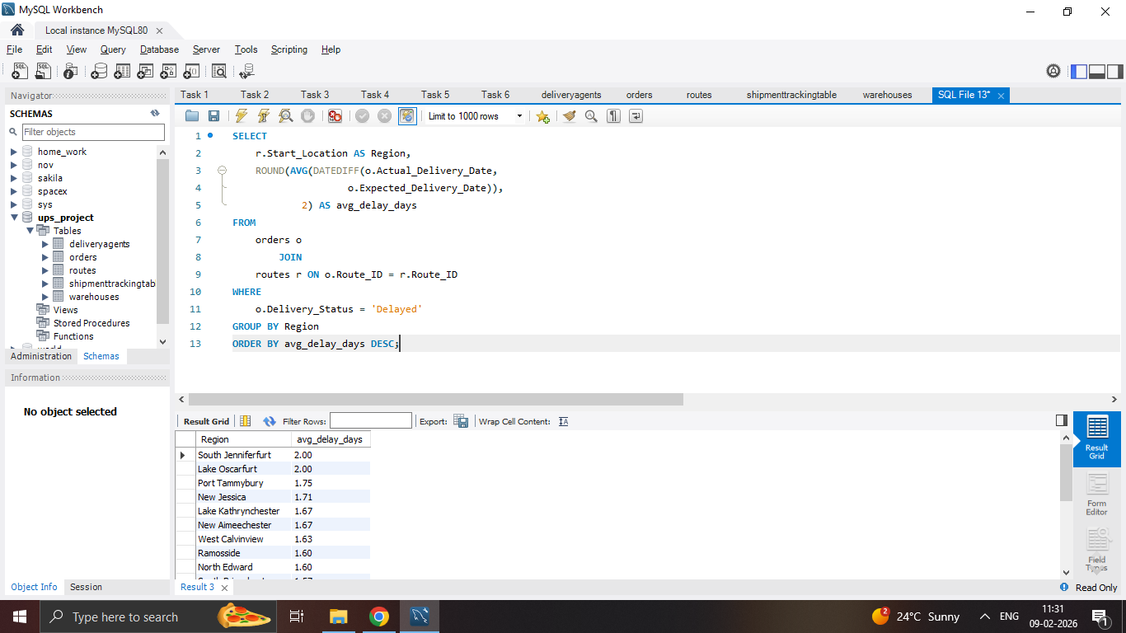
Task 7
Average Delivery Delay per Region
Result:

Slide 23
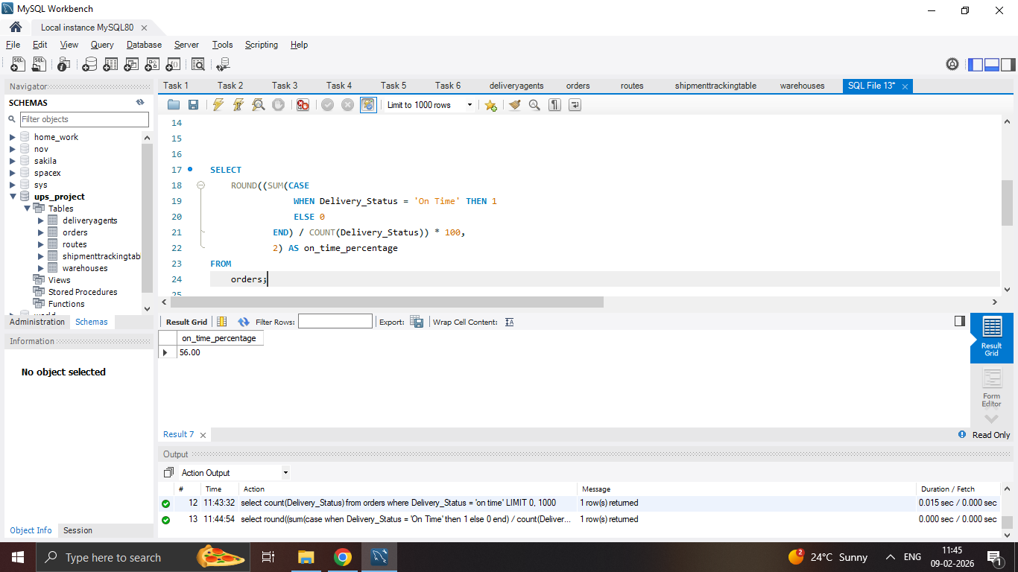
Task 7
On-Time Delivery %
Result:

Slide 24
Task 7
Average traffic delay
Result:

Slide 25
The end

